Slide 1
Fabrication of automatic windshield wiper control system with rain sensor
Project Members:
Santosh Reddy (15B81A04G0)
Raviteja (15B81A04C8)
Sri Lakshmi(15B81A04J0)
Project Guide: Mr.Selvendra

Slide 2
OBJECTIVE
This project is for automatic rain sensing car wiper and also explain the basic skeleton how the wiper automatically detects water on the windshield using sensor.
The system activates the wiper to operate in full automatic mode and detect rain using rain sensor which is interfaced to the controller then that will make the wiper to move.

Slide 3
Existing Methods
Automatic rain sensing wiper system using arduino
Automatic rain sensing wiper system using 555 timer

Slide 4
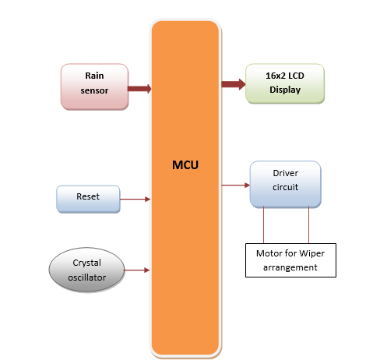
Block diagram

Slide 5
Hardware components
Regulated Power Supply.
Microcontroller.
Reset Button.
Crystal Oscillator.
LED indicators.
Rain detection sensor
DC Motors.
LCD

Slide 6
Software
PIC C compiler
PIC KIT2
Proteus

Slide 7
Rain detection sensor
Rain detection sensor will be used to find presence of rain water or moisture t the glass at front of the vehicle. We will insert this sensor at the edge of the glass frame. It always check the presence of water.
If the glass is dry then it will give information to Microcontroller that the glass is dry so need to switch on the wiper motor.
Once if rain water was detected the sensor again senses the presence of it and gives the information the microcontroller.
The same data will be send to the Microcontroller. After this information from sensor it switch ON the wiper motor.

Slide 8
Applications
Used in automobiles
Used in aircrafts
Sensor cost is low
Less power consumption
Automotive safety and convenience

Slide 9
Thank Q

